Slide 1
PYTHON PROGRAMMING
LAUNCHCODE
August 9, 2025
Asfand Khan

Slide 2
Questions + Homework Review
https://github.com/Asfandyar-Khan/LaunchCode/
Contains lectures
Powerpoint files
Google Colab
Contains homeworks
To be completed prior to class
Any unfinished or challenging questions are taken up at the start of class
Please notice a new file – “Python Project Ideas”
Any questions about last week’s homework?

Slide 3
Review of Past Class
Week 4 Homework Review
Functions
Syntax of a function
Building our own functions
Functions with no parameters, one parameters, multiple parameters
Using print statements inside functions (.format questions)
Global vs. Local Variables
range() function
What does the range function do?
What is the syntax of the range function?
How do we use the range function?
Introduction to For Loops

Slide 4
Today We Will Cover...
Week 5 Homework Review
Knowledge Check – Functions
Functions – Variable Assignment
Assigning the value of a function to a variable
Range() function
For Loop
Syntax
Usage with range() function
Lists
Tuples

Slide 5
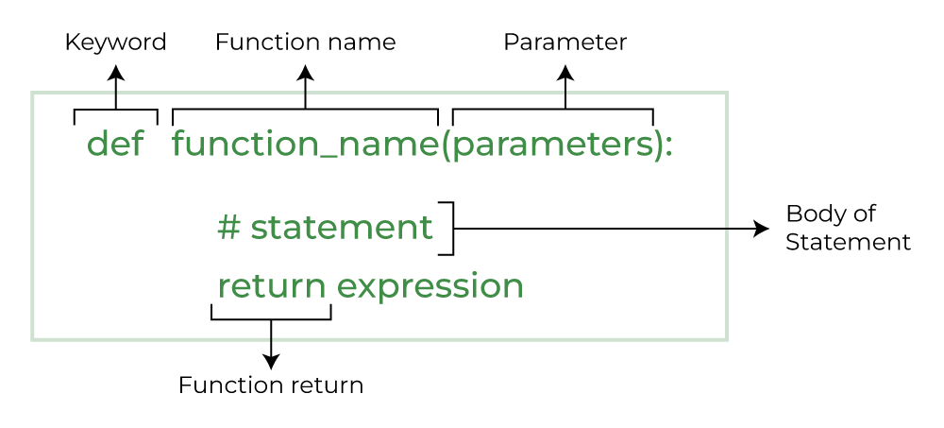
Knowledge Check - Functions
Question: Function with Multiple Parameters
Create a function called repeat_word(word, times) that prints the word multiple times based on the number provided.
Hint: First define the function, then create a local variable (inside the function) that stores word * times. Print out this result.

Slide 6
Functions – Return Values
A function can send back a result using the return statement
The return statement ends the function and sends a value back to where the function was called
Returned values can be stored in variables or used directly
Functions without a return statement send back None by default
Using return makes your functions more flexible and reusable

Slide 7
Functions – For Loops
A for loop iterates over a sequence – such as a string, list, or tuple
Allows you to run a block of code repeatedly
This occurs once for each item in the sequence
Works with either lists, strings, tuples, or range()
Syntax:
for item in iterable:
# Code to be executed for each item

Slide 8
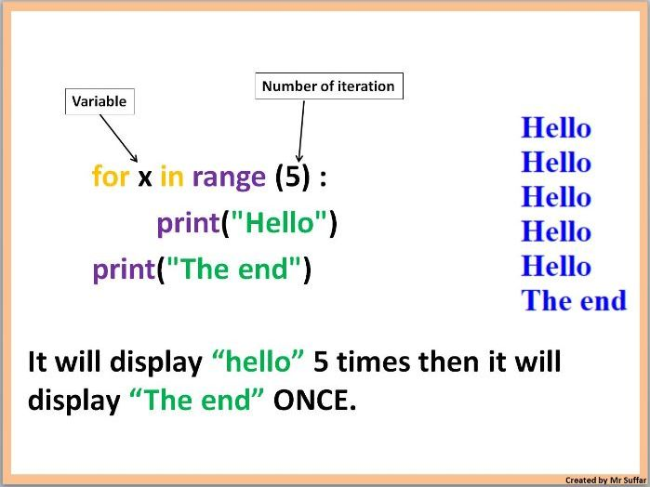
Functions – For Loops

Slide 9
Functions – For Loops, cont’d.
range() function
Commonly used in for loops
Only integers (whole numbers) can be used
Python built-in function that generates an unchangeable sequence of numbers
How is it used?
range(start,stop,step)
range(stop): this function will generate a sequence of numbers from 0 up to, but not including, stop

Slide 10
Functions – For Loops, cont’d.
range() function
range(start,stop,step): 3 parameters
range(start): initiate the sequence of numbers with the start number
range(stop): will generate a sequence of numbers from 0 up to, but not including, stop
range(step): will jump between start and stop numbers by increment of step

Slide 11
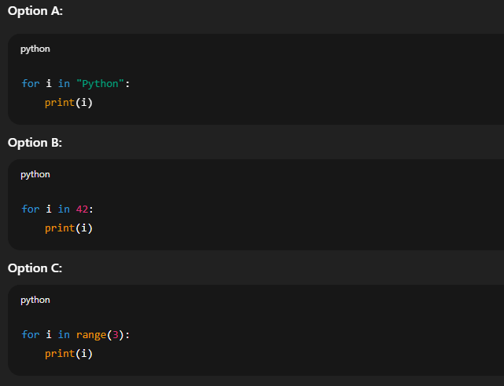
Knowledge Check – For Loops
Question: What can a for loop go through?
Which of the following will run without causing an error?

Slide 12
Knowledge Check – For Loops
Question: Using range() in for loops
Write a for loop that prints the numbers: 5,7,9,11,13
Hints:
You must use the range() function
You cannot type each number manually – use the correct start, stop, and step values
range(start,stop,step)
for variable in iterable:
# code block to repeat

Slide 13
Python Data Type - Lists
Lists
Lists are a data structure that is used to collect data items
They are mutable (changeable)
Lists maintain a defined order
The first item is given priority
Then the second item, and so on…
Items can be retrieved using index numbers (starting 0)
Items are stored in square brackets [ ]

Slide 14
Python Data Type - Tuples
Tuples
Similar to lists, tuples are a sequence of values
They are non-mutable (unchangeable)
Tuples can store different types of data (numbers, strings, etc.)
You can access items in a tuple using index numbers (starting at 0)
Tuples are useful if you want a fixed set of values that should not be modified
Items are stored in circle brackets ( )

Slide 15
Review and Questions
Homework will be posted tonight!
Asfand Khan

